Slide 1
Social Service
Diamond model

Slide 2
The purpose of model-building is not to admire the architecture of the building,
but to help us see some
order in all the disorder and confusion of facts,
systems and choices concerning certain areas of our economic and social life.

Slide 3
A model is a starting point for reflection,
analysis and application.

Slide 4
Four points of a diamond
Its duties to the state,
Its obligations to service users,
Its responsibilities to its own professional standards,
Its accountability to organizational imperatives.

Slide 5
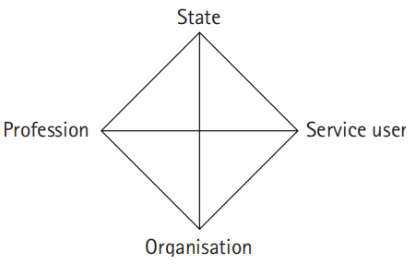

Slide 6
Social professions (e.g. health professionals, teachers, lawyers, community workers).

Slide 7
State
Social policy, social work and other social professions as part of the machinery of state support and control.
Key factors:
Roles of central government and local authorities.
National policies, legislation, taxation and government spending.
Roles of Parliament, courts, regulatory bodies.
Overlaps and tensions between these different parts of the state.
Political conflict about the proper role of the state.

Slide 8
Profession
Social policy, social work and other social professions as ‘top-down’, expert-led activities.
Key factors:
Professional attributes such as training and expertise, standards and skills, service ethic, self-regulation.
But
there are criticisms of elitism, self-interest and status, and the disabling effects of professionals.

Slide 9
Service users
Social policy, social work and other social professions as ‘bottom-up’, user-led activities.
Key factors:
Roles of individuals, families, and neighborhoods; campaign groups and self-help groups.
Concepts of participation, inclusion, empowerment, control.
But
there are tensions between different service users, and questions about how much power and choice they really have, or should have.

Slide 10
Organization
Social policy, social work and other social professions as activities that are shaped by their organizational setting.
Key factors:
Type of organization – statutory (e.g. local authority), voluntary or business?
Inter-agency working.
Processes for user involvement.
Bureaucracy and regulation.
Budgets and profits.

Slide 11
An important feature of the diamond is that there are tensions within each of the four points as well as between them.
So, within the state there may sometimes be conflict between political priorities and court decisions, and there is often tension between central and local government.
There may be tensions between different service users (e.g. a child and parent), and between service user groups, particularly in a world of limited resources.
Organizations are torn between being lean and efficient, or flexible and open.
Professionals have to reconcile their responsibilities to the state, service users and the organization.

Slide 12
The four points are continually interacting with one another, adapting themselves and bringing about change in the others in a dynamic, on-going manner.
For example, notions of professionalism have changed to accommodate the greater emphasis now placed on involving service users – listening to their views and empowering them to make their own choices are now seen as professional things to do.

